Slide 1
Neural Networks and AI
Cody Bellamy, Justin Steiner

Slide 2
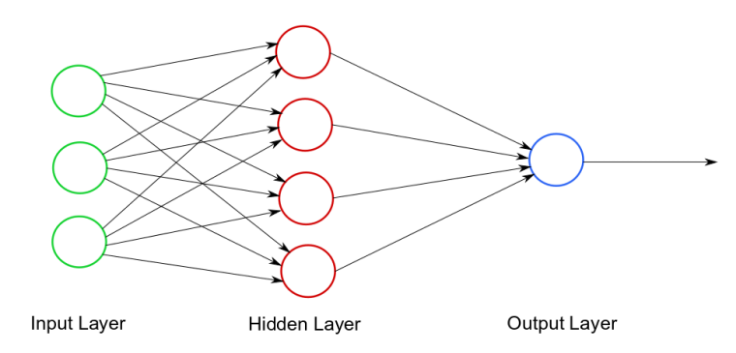
Neural Networks
Each arc has a weight
Each node has a bias
Each node’s output needs to be within a known range (activation functions)
Notes:
Picture: https://www.kdnuggets.com/2017/09/neural-network-foundations-explained-activation-function.html

Slide 3
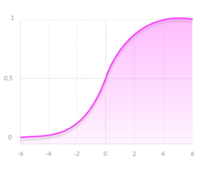
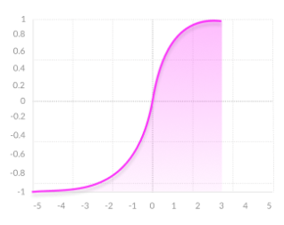
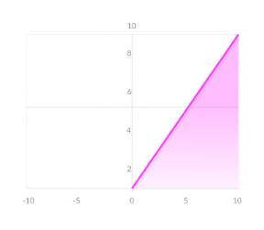
Activation Functions
Sigm TanH Relu
Notes:
Pictures: https://missinglink.ai/guides/neural-network-concepts/7-types-neural-network-activation-functions-right/

Slide 4
Our Problem
We don’t know which weights and biases will be the best for our networks
So how do we choose them?
We choose random weights and biases
Then optimize them using an optimization algorithm

Slide 5
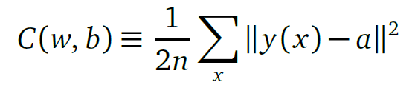
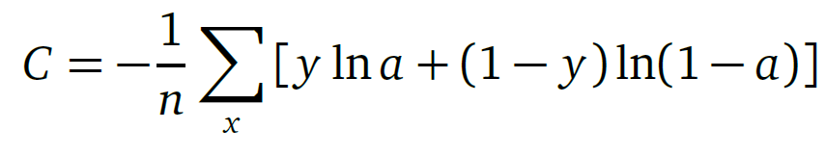
Cost Functions
Quadratic Cost (Mean Squared Error)
Cross Entropy Cost

Slide 6
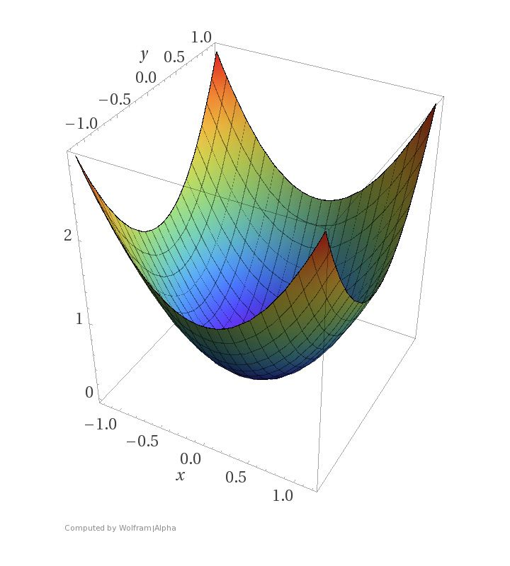
Gradient Descent
Most likely starting out towards the edges where error is high
Goal is to take small, fast steps towards the minimum of our function
Notes:
Picture: https://blog.paperspace.com/intro-to-optimization-in-deep-learning-gradient-descent/

Slide 7

Youtube Video Analysis
35,623 rows.
Each row is 1 video
Columns:
number of likes
number of dislikes
number of comments
whether or not a video has over 1,000,000 views (response)
86% success rate
Notes:
Picture: https://www.youtube.com/about/brand-resources/#logos-icons-colors

Slide 8
Lessons Learned
Know what your hyper parameters do
Learning rate -> small steps
Batch size -> fast
Number of epochs -> number of steps to take
Apply transformations and experiment with data
Experiment with different optimization algorithms

Slide 9

Digit Recognition
60,000 Rows in the training set
10,000 Rows in the test set
784 columns each corresponding to a pixel
0-255 the range of pixel values
1 column corresponding to the digit’s label
0-9
97% success rate
Notes:
Picture: https://kx.com/blog/kxcon2016-puzzle-challenge/

Slide 10
Lessons Learned
Sometimes you need to do things by hand
Take breaks, step back and look with fresh eyes
Libraries are only powerful if you know how they work

Slide 11
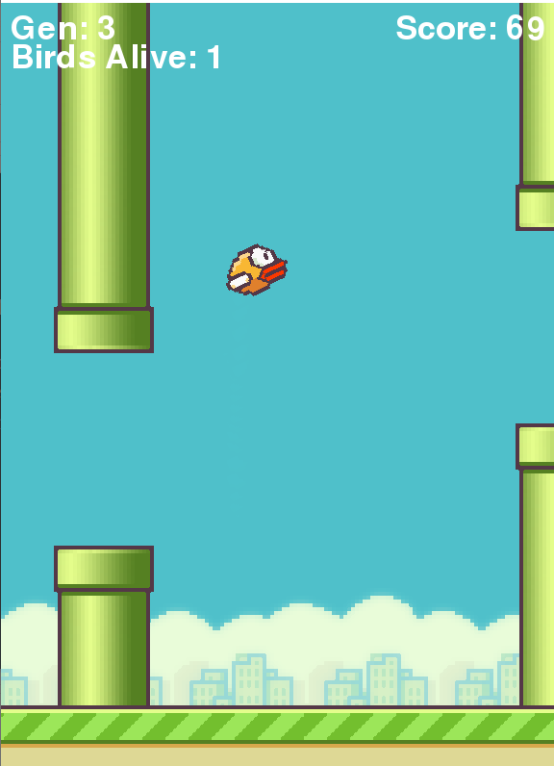
Genetic Learning
Creates population of Neural Network Objects
Initial population acts randomly
Calculate how well each instance of the network is doing based on a ‘fitness’ score
Take the most fit and have them as the ‘parents’ for the next generation
Mutate the ‘children’ of the generation and repeat

Slide 12
Lessons Learned
Don’t be discouraged by infrequent bugs
Take baby steps towards your end goal

Slide 13

Reinforcement Learning
Set up a reward function
Does not have to be continuous
Create an instance of a network with a method for storing the results of the output (recurrence)
For any given action, generate a reward (negative rewards are considered punishments) and store it within the network
Set up an algorithm so that future reward is maximized

Slide 14
Lessons Learned
Understand the big picture of your project
Break up your project into smaller problems
It’s ok to get a specific solution, and then generalize it

Slide 15
Future Goals
Computer Vision and object detection
Being able to classify and locate different types of things in a picture
Our goal is to classify boats on the water

Slide 16
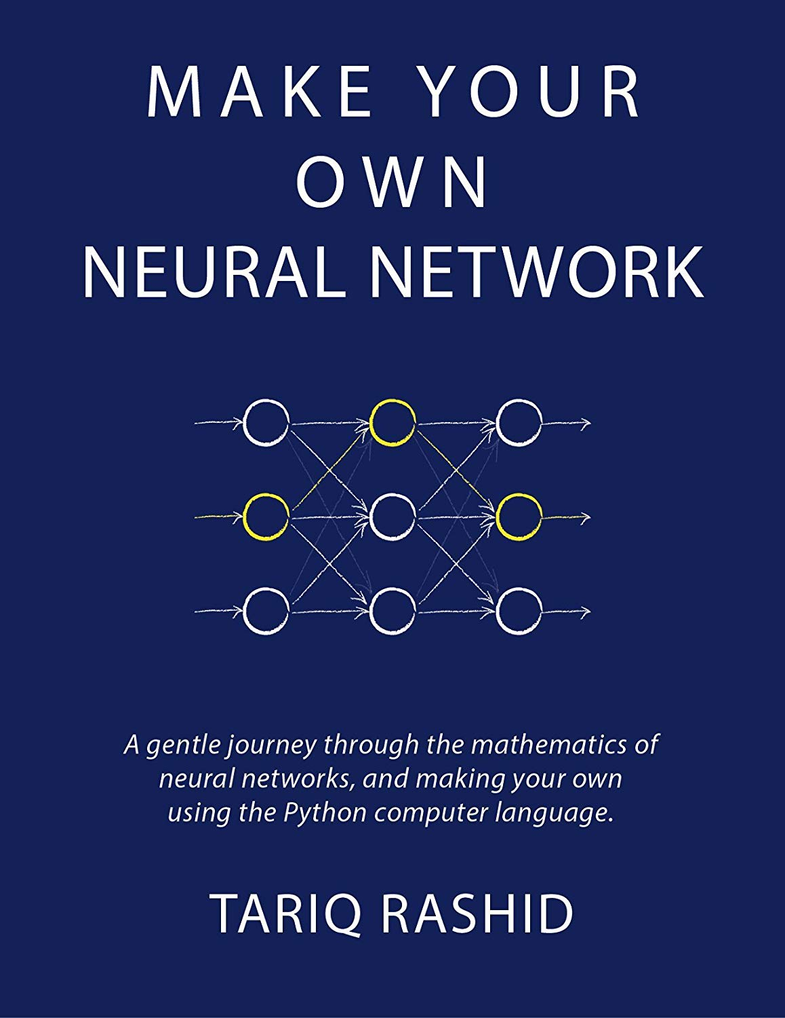
You Can Do this Too!!!!
Any Questions?
Notes:
Picture: https://www.amazon.com/Make-Your-Own-Neural-Network-ebook/dp/B01EER4Z4G

